Slide 1
TIME BASED APPLIANCE CONTROL WITH REAL TIME FEEDBACK
BY MEMBERS
PRANAV K P(927624BEC158)
POOVENTHAN K(927624BEC156)
PONRASU P(927624BEC155)
NIVASH S(927624BEC153)
NITISH P(927624BEC151)

Slide 2
ABSTRACT
Problem:
The rapid increase in electricity consumption, coupled with inefficient appliance usage, results in unnecessary energy wastage and higher utility costs. Traditional appliance control methods lack precise scheduling and fail to provide real-time operational feedback, making it difficult for users to track energy patterns or respond to unexpected malfunctions. Moreover, manual intervention often leads to inconsistent energy-saving practices, reducing the effectiveness of conservation efforts.
Solution:
To address these challenges, this project proposes a time-based appliance control system with integrated real-time feedback. The system enables users to set predefined operational schedules for appliances, ensuring automatic activation and deactivation at optimal times. Real-time monitoring provides instant feedback on power consumption, appliance status, and irregularities, empowering users to take immediate corrective actions. By merging automation with continuous performance insights, the solution enhances energy efficiency, reduces human dependency, and supports informed energy management decisions. This approach not only optimizes appliance usage but also contributes to cost reduction and environmental sustainability.

Slide 3
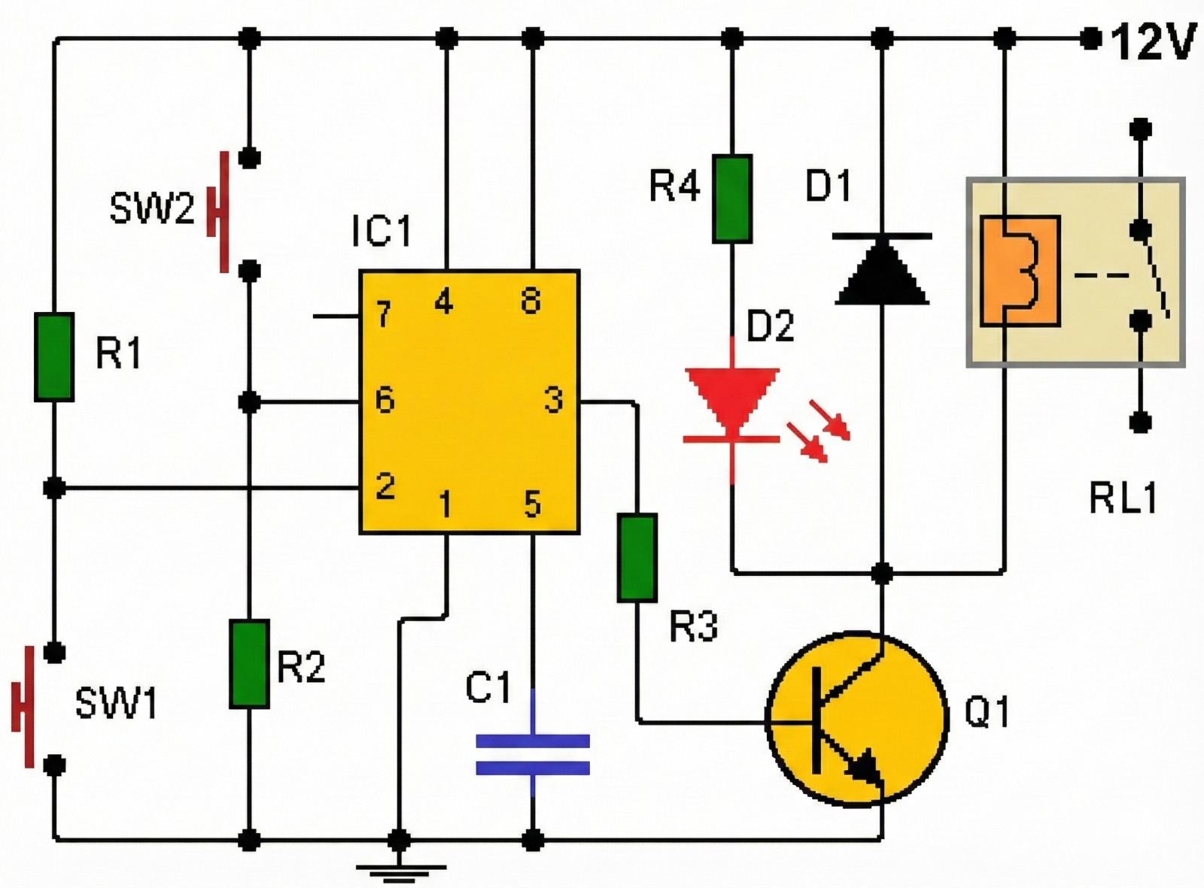
BLOCK DIAGRAM

Slide 4
COMPONENTS AND ITS USES
NE555 Timer IC: Generates timing pulses for LED control.
10K Resistor: Sets timing parameters with capacitor.
470μF Capacitor: Controls timing interval by charging/discharging.
Potentiometer (POT): Adjusts timing duration by varying resistance.
Switch (S1): Triggers the timer to start the timing cycle.
NPN Transistor: Acts as a switch controlling current flow.
LED: Visual output indicating timer activation.
220Ω Resistor: Limits current to protect the LED.
Power Supply (5-12V): Powers the entire circuit.

Slide 5
Real-time Applications
1. Smart Home Energy Management
Automatically runs washing machines, water heaters, or air conditioners during off-peak electricity hours.Sends real-time energy usage alerts to homeowners via mobile apps.
2. Industrial Equipment Scheduling
Controls heavy machinery to operate only in pre-set time slots to avoid peak tariffs.
Provides real-time performance data to maintenance teams to detect faults early.
3. Office and Commercial Buildings
Automates lighting, HVAC (heating, ventilation, air conditioning), and office equipment according to working hours.
Tracks live energy usage per department to optimize resource allocation.
4. Agriculture and Irrigation Systems:
Operates water pumps or greenhouse equipment at specific times for optimal crop watering and temperature control.

Slide 6
HOW WILL THE TIME BASED APPLIANCE CONTROL WITH REAL TIME FEEDBACK Helps the User
Saves Energy: Turns appliances ON/OFF automatically, reducing power waste.
Convenient: Automates daily routines, no manual switching needed.
Safe: Prevents overheating and fire hazards by limiting run-time.
Instant Status: Shows live appliance status and alerts on faults.
Flexible: Allows quick schedule changes based on needs.
Maintenance Alerts: Reminds when service is required.

Slide 7
THANK YOU

